Slide 1
Grocery Store Management System

Slide 2
Presenter Information
Name: S M Mahamudul Haque
Student ID: 2677527

Slide 3
Introduction
Project: Grocery Store Management System (Python/Flask web application)
Objective: Create a full-stack web app to help grocery store owners manage inventory, products, categories, and customer orders.

Slide 4
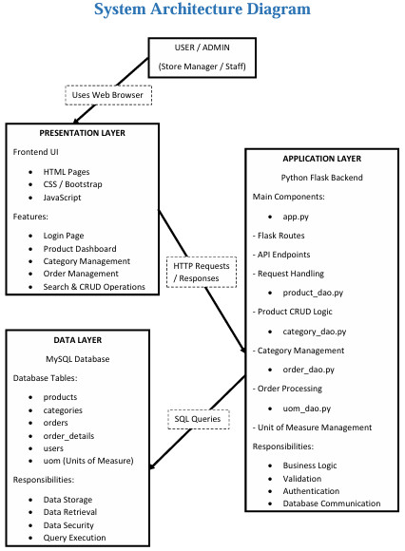
System Architecture Diagram
Three-tier architecture
Frontend → Flask Backend → MySQL Database
REST APIs handle communication
Data stored and retrieved through SQL queries

Slide 5
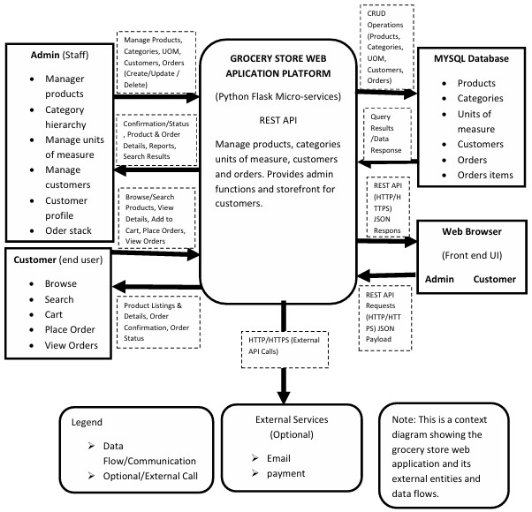
Context Diagram
External Entity: Admin User (grocery store manager) – the main actor interacting with the system via a web browser.
System (Grocery App): Provides services like authentication, product/category management, order processing, and reporting.
Data Store: MySQL Database – stores all persistent data (users, products, categories, orders, etc.).
Interactions: Admin sends inputs (login credentials, product info, order details); system outputs data/results to Admin (confirmation, lists, reports).

Slide 6
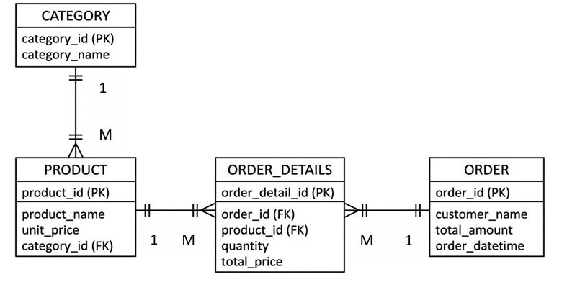
Database Design (ER Diagram)
Entities & Attributes: CATEGORY, PRODUCT, ORDER, ORDER_DETAILS
Relationships: One-to-many {Category (1) → Product (M)}, One-to-many {Product (1) → Order_Details (M)}; One-to-many {Order (1) → Order_Details (M)}, Many-to-Many.

Slide 7
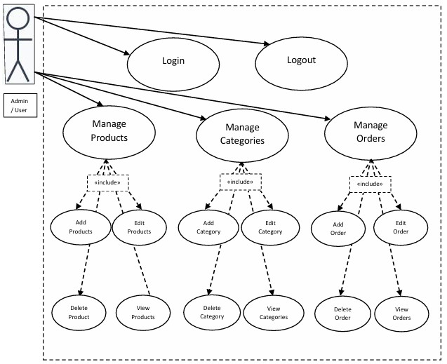
Use Case Diagram
Actor: Admin
Use Cases:
Manage Products: Add, Update, Delete, View Product
Manage Categories: Add, View Category
Manage Orders: Create (place) Order, View Orders
Structure: Admin initiates each use case; “Manage Products” includes the sub-cases Add/Update/Delete/View. Similarly for categories and orders.

Slide 8
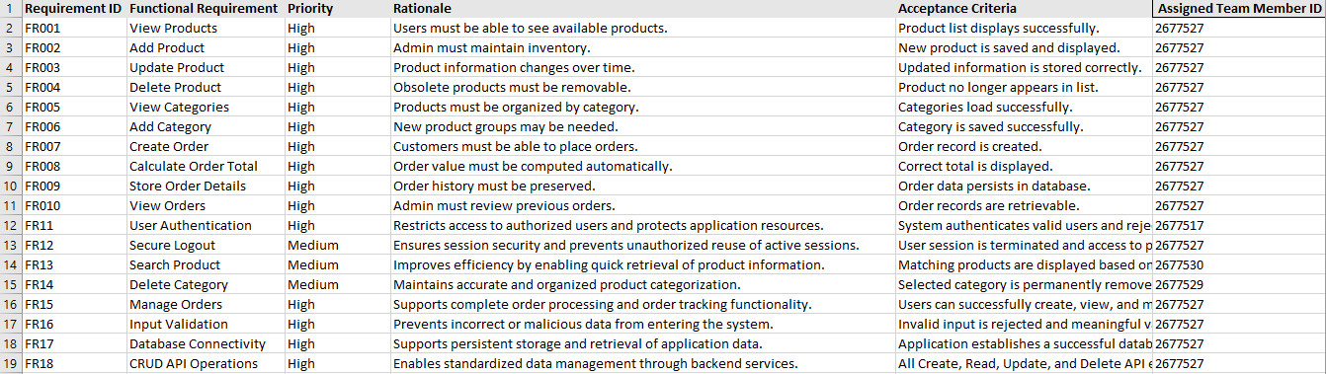
Functional Requirements (FRs)
Product Management: View products list; Add new product; Update product details; Delete product.
Category Management: View categories; Add new category.
Order Processing: Create a new order (select products, compute total, save order); View existing orders.
Data Handling: Calculate order total from product quantities/prices; Store order details in database.
Validation: Validate user inputs on all forms (e.g., no empty product names).

Slide 9
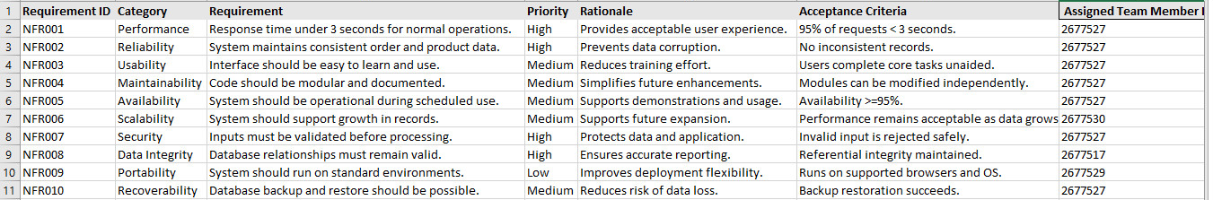
Non-Functional Requirements (NFRs)
Performance: Fast response (target < 3 seconds for key actions) to ensure smooth user experience.
Reliability: Data consistency and accuracy (no data loss or corruption), transactional integrity for orders.
Usability: Intuitive, user-friendly interface (we used a clean Bootstrap template).
Maintainability: Modular code structure (using DAO classes and clear MVC separation) to simplify future updates.
Scalability: Design supports growing data (e.g., more products) without major redesign.
Security: Although no login was implemented in our base project, the system is ready for future authentication/authorization layers if needed.

Slide 10
Presenter Information
Name: Hosen Aiyub
Student ID: 2677530

Slide 11
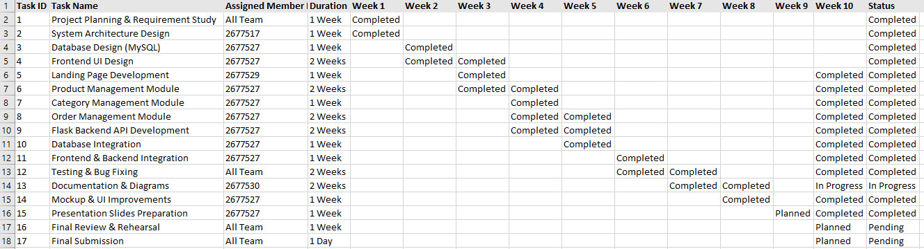
Project Plan (Gantt Chart)
Timeline: 10-week plan.
Major Phases:
Planning & Architecture Design – defined requirements, created diagrams (Context, ER, UML).
Database Schema Design – modeled ERD and created MySQL database (Week 2).
Back-End & DAO Implementation – coded Flask routes and DAO classes (Weeks 4–5)..
Documentation & Final Prep – prepared reports, slides, and presentation (Weeks 8–10).

Slide 12
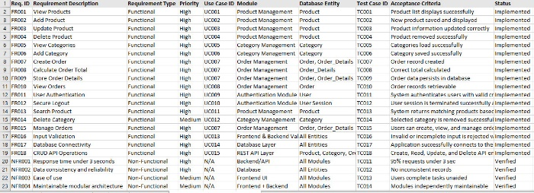
Requirements Traceability Matrix (RTM)
Purpose: Maps each requirement to its source, design, and testing artifacts.
Elements Traced:
Use Case: which use-case covers the requirement.
Module: which code component implements it.
DB Entity: which database tables it involves.
Test Case: which test verifies it.

Slide 13
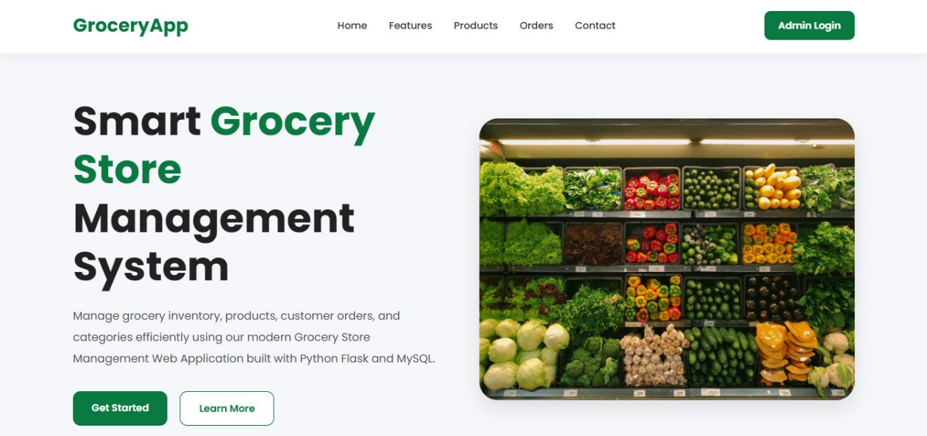
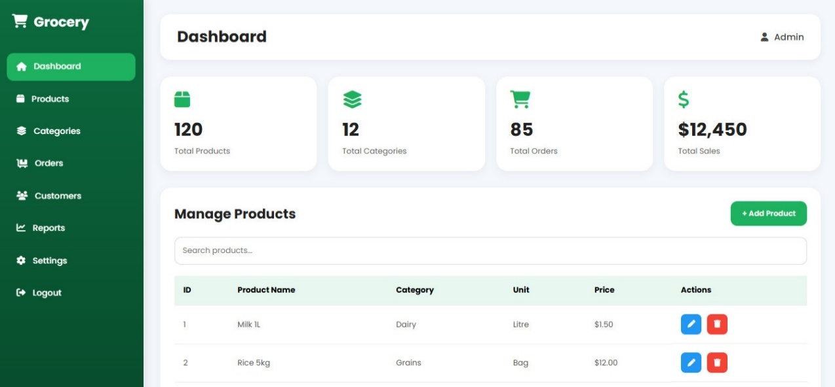
User Interface (Landing Page & Mockup)
Landing Page
Mockup

Slide 14
Presenter Information
Name: Hossain Md Miraj
Student ID: 2677529

Slide 15
Implementation Highlights
Technology Stack: Python (Flask) for back-end; HTML/CSS/Bootstrap/JavaScript for front-end; MySQL database.
Code Structure:
Controllers/Routes: Flask routes handle web requests for each use case (e.g., /addProduct, /viewOrders).
DAO Layer: Separate classes handle SQL queries (e.g., ProductDAO.create(), OrderDAO.getAll()) to keep DB logic modular.
Templates: Jinja2 HTML templates render dynamic pages (e.g., add_product.html).
APIs: CRUD operations exposed as HTTP endpoints (our requirements include “CRUD API operations”).
Validation & Testing: Forms include input validation (no empty fields). We wrote test cases for major flows (e.g., adding a product, creating an order).
Running the App: (E.g., run app.py and open http://localhost:5000 in a browser; ensures MySQL service is running.)

Slide 16
Conclusion & Future Work
Status: All core objectives implemented and tested. Functionalities work as intended (as shown in testing and the demo).
Documentation: Comprehensive models and artifacts (Context & Data diagrams, UML, Gantt, RTM) are complete.
Learnings: We gained full-stack development experience: designing a DB schema, building APIs, and creating a user-friendly UI.
Future Improvements: Possible enhancements include user authentication/login, advanced search filters, and better reporting (e.g., sales analytics).

Slide 17
THANK YOU

